Slide 1
Linux basics and bash scripting
Part 1
Based on https://michael-herbst.com/teaching/advanced-bash-scripting-2017/

Slide 2
Table of contents
Introduction to Unix-like operating systems
A first look at the bash shell
Simple shell scripts
Control structures and Input/Output
Arithmetic expressions and advanced parameter expansions
Subshells and functions

Slide 3
Introduction to Unix-like operating systems
Part 1

Slide 4
Introduction to Unix-like operating systems
UNIX itself is quite an old operating system (OS) dating back to the 1970s.
developed by Dennis Ritchie, Ken thompson and others at bell labs
Included important new concepts, now known as the Unix philosophy
Unix philosophy in a nutshell:
Write programs that do one thing and do it well.

Slide 5
Unix philosophy
The OS is a collection of small helper programs or “utilities“, that only do a simple thing (think about ls, mkdir . . . )
– programs (”shell scripts“) that combine the utilities to achieve a bigger task.
• The OS is extremely modular:
– All programs have a well-defined interface
– It is easy to swap one program for a modified/enhanced version without breaking the rest of the OS
• The OS is standardised:
– The functionality of the programs is (almost) identical for all OSes of the Unix-family.

Slide 6
Impact for scripting
On such a platform scripting becomes very helpful since
• all important functionality is available in the OS-provided utilities. So very little actual code has to be written to glue the utilities together.
• the utilities are not too specific for a particular job and can therefore be used flexibly throughout the script.
• documentation of their interfaces (commandline arguments) is available.
⇒ If one changes from one Unix-like OS to another or from one version of the OS to the next, no change in the functionality of the derived script is to be expected.
⇒ Scripts become reusable and portable

Slide 7
The Unix utilities
Now let us briefly review some of the most important utility programs on a modern Unix-like OS.
This section is just to remind you about these commands.
If more detailed information is required you should consult the manpage by typing man command

Slide 8
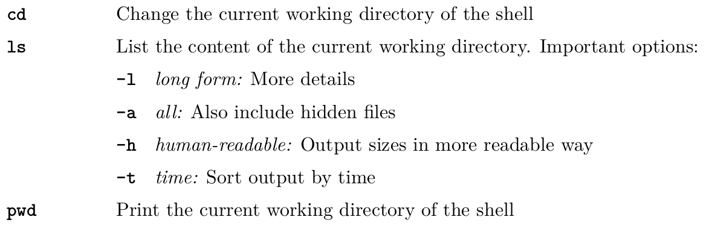
Accessing files or directories

Slide 9
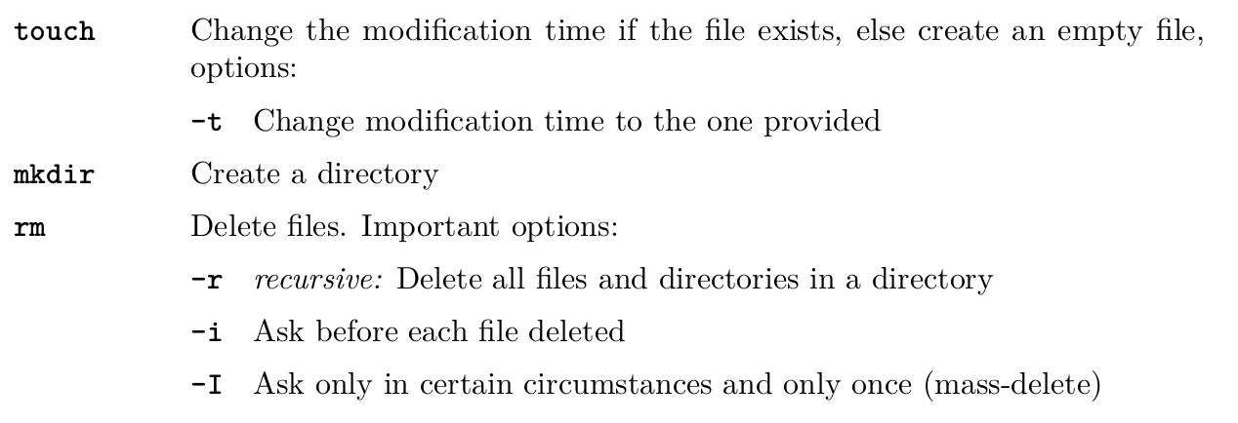
Modifying files or directories

Slide 10
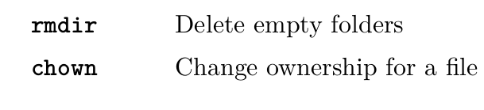
Modifying files or directories - Cont

Slide 11
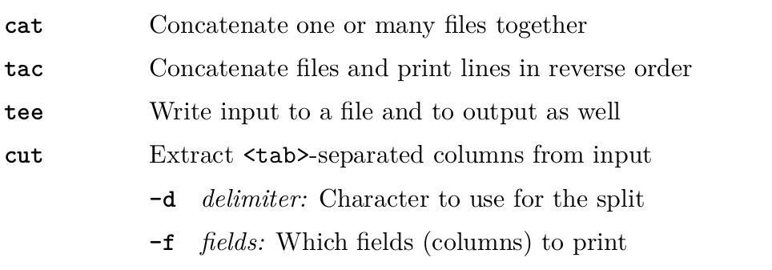
Getting or filtering file content

Slide 12
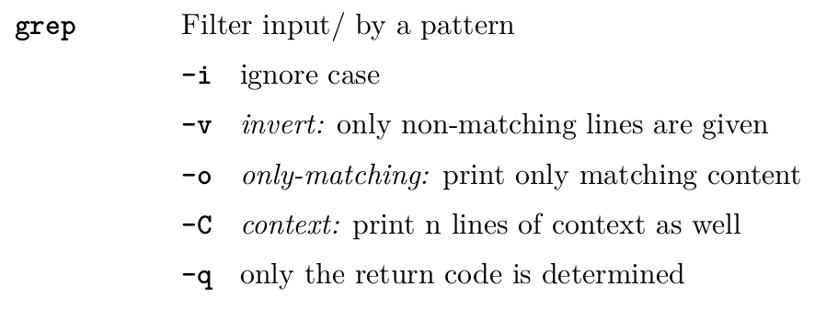
Getting or filtering file content - Cont

Slide 13
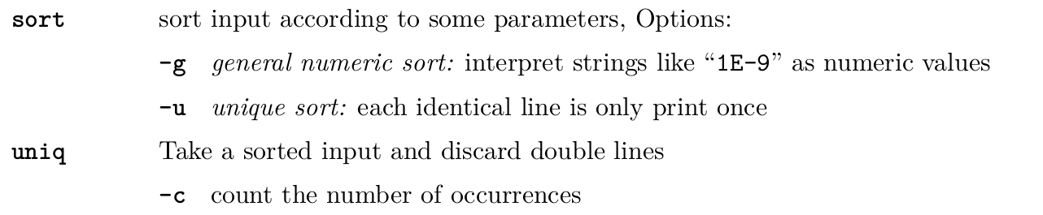
Getting or filtering file content - Cont

Slide 14
Example 1.1.
In this example we will assume that the current working directory is the Exercises directory of the git repository for this lesson (06 - shell scripts)
If we run
We get the content of the file resources/matrices/3.mtx
If we do the same thing with tac, we get the file again, but reversed line by line.

Slide 15
Example 1.1
Many of you probably already know the < character can be used to get the input for a command from a file. I.e. the command
takes its input from the file we just looked at and passes it onto cut
This will not print what we expect since the file is not tab based
This will tell cut to use the space character as a delimiter

Slide 16
Example 1.2
In this example we want to find all lines of the Project Gutenberg books
pg74 and pg76 that contain the word “hunger”
or we can use the pipe “|” to connect the cat and grep commands together like

Slide 17
Example 1.3
There exists a counterpart to “<” which writes to a file, namely “>”.
it just takes the output from the last command and writes it to the file
These two commands have the same effect

Slide 18
Example 1.4.
Since uniq can only operate on sorted data, it is very common to see
for example
This can of course be replaced by the shorter (and quicker)

Slide 19
Example 1.4. - Cont
in many cases a construct like < file command” can actually be replaced
by “ command file ”.

Slide 20
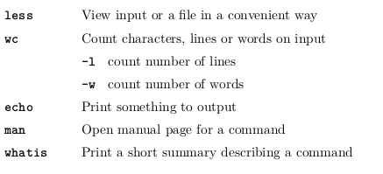
Other

Slide 21
Example 1.5.
If we want to find help for the commands tail and head, we could use
the manpage
Even man itself has a manpage, e.g.

Slide 22
Exercise!
Exercise 1.1 - 1.3

Slide 23
The Unix file and permission system

Slide 24
What are files?
• Convenience feature for programmers or users of the computer
• File: Virtual chunk of data.
• File path: Virtual location where user expects the file.
• File system: Provides lookup feature to translate file path to hard drive location
• Lookup mechanism incorporates extra information about the file:
– Owner (Person who created the file)
– Group (Group of people file is attributed to)
– Permissions for file access
– Time when file was created/accessed/modified

Slide 25
What are files? - Cont.
• All this information can be obtained using the ls -l command
• Some files are “special”, e.g.
– soft links: Files that point to a different file path
⇒ OS performs look-up at the other file path
– hard links: Duplicated entries in the lookup mechanism
⇒ Two paths point to the same hard drive location

Slide 26
Unix paths
Paths are a structured syntax that allow the user to tell the operating system which file
he or she is referring to. In Unix these paths are characterised as follows:
• Entities on the path are separated by “/”
• The last entity may be a file or directory, all the others are directories 5
• Absolute path: Path starting at the root directory, i.e. who has “/” as the first character

Slide 27
Unix paths - Cont.
• Relative path: Gives a location relative to the current directory. May contain “..” to denote the parent directory relative or “.” to denote the identical directory to the entity on the left. E.g. the paths
are all relative paths to exactly the same location.

Slide 28

Unix permissions
Consider the following output of the command ls -l
The output means from left to right:
• Permissions (10 chars)
– 1 char (here d or -): Indicates the file type
– 3 chars: Access rights for the owner
– 3 chars: Access rights for the group
– 3 chars: Access rights for the world (anyone else on the machine)
– r means read, w means write, x means execute

Slide 29
Unix permissions - Cont.
• Number of hard links to this hard drive location
• Owner
• Group
• Size (in bytes)
• Last modification time
• File name

Slide 30
Unix permissions - Cont.
A file is (readable/writeable/executable) for a specific user if at least one of the following is true:
• He is the owner and the owner (r/w/x)-bit is set (i.e. ls shows the respective letter in the listing)
• He is in the group the file belongs to and the group has the (r/w/x)-bit set
• The (r/w/x)-bit is set for the world

Slide 31



Example 1.9
The permissions can be changed using the command chmod and the owner and group information can be changed using chown.
After a run of chmod +x secret the ls -l would show
Further running chmod g-r file gave the result

Slide 32
A first look at the bash shell
Part 2

Slide 33
Historic overview

Slide 34
What is a shell?
Back in the days:
• Terminal: Place where commands can be keyed in in order to (compile and) execute
programs which do the work on a computer
• Shell: Interface the OS provides to the user on a terminal

Slide 35
What is a shell?
Nowadays:
• Hardly any work done from actual terminals any more
• Programs to start a virtual terminal: “Terminal emulator”
• Shell: Default program started by the terminal emulator

Slide 36
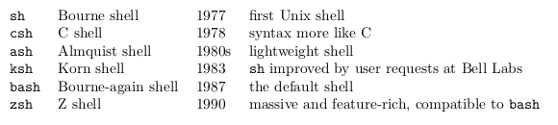
The Bourne-again shell
bash is short for Bourne-again shell
• derived and improved version of the Bourne shell sh
• Pretty much the default shell on all Unix-like OS
Other important shells

Slide 37
Handy features of the bash

Slide 38
Tab completion
• Can save you from a lot of typing
• Needs to be loaded by running (if not already done automatically)
• Press <TAB> once to complete a command
• Press <TAB> <TAB> to get a list of possible completions
• Works on files and command options, too.

Slide 39
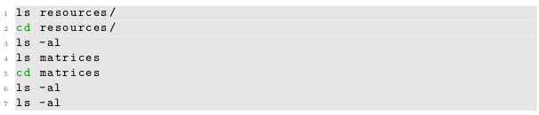
Accessing the command history
Consider a sequence of commands
• It would be nice to do as little typing as possible
• Fortunately the bash remembers what was most recently typed
• Navigation through history using <UP> and <DOWN> arrows
• The last line can also be executed by <UP> <ENTER>

Slide 40
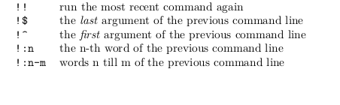
Accessing the command history - Cont.
Another way of accessing the history is given by the so-called history expansion, e.g.

Slide 41
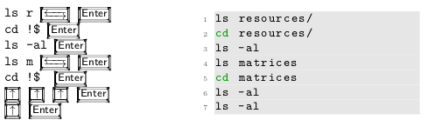
Accessing the command history - Cont.
So if we assume the working directory is the top level directory of the git repository for this course, we could just type
to achieve the same thing as we did in the previous slide.

Slide 42
Accessing the command history - Cont.
Another feature worth mentioning here is reverse-i-search. In order to transform the shell in this mode type Ctrl + R and . . .
• Start typing
• The shell will automatically display the most recent command matching command line
• type Enter to execute
• type more chars to continue searching
• use ← , → , Home , End , . . . to edit the current match, then Enter to run the edited version
• type Ctrl + R to go to the next match further back in the history
• type Ctrl + C to abort

Slide 43
Accessing the command history - Cont.
Note, that both tab completion as well as the bashs history features do only work in an interactive environment and not when writing scripts.
A few other bash keystrokes worth trying out:
• Ctrl + W deletes the word on the left
• Ctrl + K “kills” (deletes) the line to the end of the line
• Ctrl + U deletes the line till the beginning

Slide 44


Quiz!
What is the smallest number of keystrokes you need to achieve the execution of the following command sequences.
Assume as usual that the current working is the top level of the repository.
Assume further that the command history is filled exactly with these entries (from oldest to newest):
Count special symbols like “_” or “|” and all CTRL commands as 1 keystroke

Slide 45

Solution to Quiz
One way of doing this could be:
This makes 5 + 11 + 9 + 22 = 47.

Slide 46
Running multiple commands on a single line
The bash offers quite a few ways to separate subsequent commands from one another.
The simplest one, which everyone has used already multiple times just for this course, is the newline character (as produced by the Enter key).
The character ; is entirely synonymous to Enter . So typing
cd -; ls <Enter>
Or
cd - <Enter>
ls <Enter>
is equivalent.

Slide 47
Running multiple commands on a single line
In contrast the character & tells the bash to send the program on its left to background and immediately proceed with the execution of the next command.
This is extremely helpful for running long jobs without blocking the shell, e.g.
would start copying the big file BigFile to the USB Stick and immediately display the
content of resources file
During the execution of the background job cp BigFile /media/usbstick/, output from both jobs will be displayed on the terminal.

Slide 48
Redirecting command input/output
Each command which is run on the terminal per default opens 3 connections to the shell
environment:
• stdin or file descriptor (fd) 0: The command reads all input from here.
• stdout or fd 1: All normal output is printed here.
• stderr or fd 2: All output concerning errors is printed here.
Usually one can expect error messages on stderr, everything else on stdout.

Slide 49
Redirecting command input/output
There are a few good reasons to distinguish stdout and stderr:
1. In many cases one is only interested in part of the output of a program
⇒ One pipes the program into grep
⇒ Only a small portion of the output produced reaches the eye of the user
• But: We still want to see all the errors
2. Scripts often capture the output of a program for later use.
⇒ Programmer only expects normal output in the capture, no error messages
⇒ Can capture stdout and stderr separately.

Slide 50
Redirecting command input/output
3. Usually one can safely discard the output on stdout whereas stderr is typically still important to watch for any unforseen issues.
⇒ Implicitly output split into two categories for sensible logging.

Slide 51

Redirecting command input/output
By default stdin is connected to the keyboard and both stdout and stderr are connected to the terminal.
Running a comm in the shell gives a redirection diagram like

Slide 52
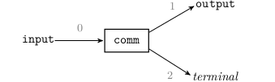
Redirecting command input/output
As we already know the characters < and > can be used to read/write from/to a file, so the commandline
can be visualised as

Slide 53
Redirecting command input/output
If we want to prevent the content of the file output to be overwritten, we can use the syntax
This does exactly the same thing as the previous, just it appends stdout to the file output instead of deleting the previous content and replacing it by the output of comm.

Slide 54
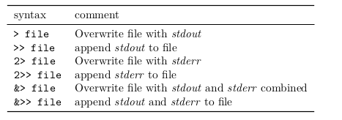
Redirecting command input/output
Summary of the output redirectors of the bash shell.
The versions with a single > always substitute the content of the file entirely, whereas the >> redirectors append to a file.

Slide 55
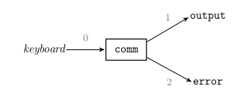
Redirecting command input/output
If one wants to redirect the output on stderr to a file called error as well, we can use the commandline
or pictorially

Slide 56
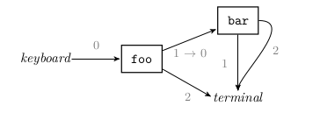
Redirecting command input/output
Many more output redirectors exist.
They all differ only slightly depending on what file descriptor is redirected and whether the data is appended or not.
Similar to output redirection >, a pipe between commands foo | bar only connects stdout to the next command but not stderr.

Slide 57
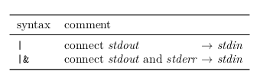
Redirecting command input/output
Again there is also a version that pipes both stdout and stderr to the next command, see table below

Slide 58
Redirecting command input/output
One very common paradigm in scripting is output redirection to the special device files /dev/null or /dev/zero.
These devices have the property, that they discard everything which gets written to them.
Therefore all unwanted output may be discarded by writing it to e.g. /dev/null

Slide 59
Redirecting command input/output
For example, consider the script 2_intro_bash/stdout_stderr.sh 2
If we wanted to get all errors but we are not very much interested in stdout, then running the following will achieve that
If we want it to be entirely quiet, we could execute

Slide 60
The return code of a command
Apart from writing messages to stdout or stderr, there is yet another channel to inform the user how the execution of a program went:
• Each command running on the shell returns an integer value between 0 and 255 on termination, the so-called exit status or return code.
• By convention 0 means “no errors”, anything else implies that something went wrong.
• The meaning of a specific code can be checked from the program’s documentation
(at least in theory).

Slide 61
Redirecting command input/output
The return code is usually not printed to the user, but stored by the
shell.
• In order to get the exit code of the most recently terminated command one may
execute echo $?.
• Since this is in turn a command, this by itself alters the return code and hence effects the value printed by the next execution of
echo $?.

Slide 62
Exercise!
Exercises 2.1- 2.4

Slide 63
Logic based on exit codes: The operators &&, ||, !
We already looked at the & and ; operators for separating commands in a command list, e.g.
In both cases there is no control about the execution of bar
Bar is executed in both cases

Slide 64
Logic based on exit codes: The operators &&, ||, !
If we want execution of the bar command only if
foo succeeds or fails, we need the operators && or ||, respectively:

Slide 65
Logic based on exit codes: The operators &&, ||, !
A few examples:
• Conditional cd:
• If the annoying error message should be filtered in case blub does not exist, one
could run
• Very common when developing code

Slide 66
Logic based on exit codes: The operators &&, ||, !
A list of commands connected by && is called an “AND list” and a list connected by || an “OR list”.
• One can also intermix && and ||
although this can lead to very hard-to-read code and is therefore discouraged.

Slide 67
Logic based on exit codes: The operators &&, ||, !
Finally there also exist the operator ! that inverts the return code of the following program. So running
returns the exit code 1 if ls has been successful and 0 on error.

Slide 68
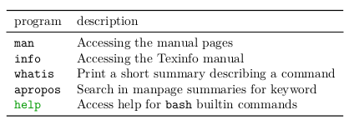
Tips on getting help
It is not always clear how to get help when writing a script or using the commandline.
Many commands exist that should provide one with these answers.

Slide 69
Tips on getting help
If one knows the name of a command usually a good procedure is:
1. Try to execute command --help or command -h. Many commands provide a good summary of their features when executed with these arguments.
2. Try to find help in the manpage man command.
3. If the manpage did not answer your problem, try accessing the latter using info command.
4. If both is unsuccessful the command is probably so-called shell builtin.
In this case try finding help via help command.

Slide 70
Exercise!
Exercises 2.5 - 2.9

Slide 71
Simple shell scripts
Part 3

Slide 72
What makes a shell script a shell script?
The simplest script consists of the so-called shebang
This line, starting with a hash(#) and a bang(!) tells the OS which
program should be used in order to interpret the following commands

Slide 73
What makes a shell script a shell script?
In order to compose a shell script we hence need two steps
• Create a file containing a shebang like #!/bin/bash
• Give the file executable rights by calling chmod +x on it.

Slide 74
Executing scripts
Once script files are made executable using chmod +x
we can execute it on the shell like any other command.
Consider the simple script
If the current working directory of the shell is hello.sh is, we run it by executing

Slide 75
Executing scripts
Otherwise we need to call it by either the full or the relative path
E.g.
if we are in the top directory of the course git repository, we need to execute
You can see this script in the Git repo for this course
Go ahead and try to run it!

Slide 76

Scripts and stdin
Similar to other commands, scripts by themselves can also process data provided on their stdin.
Take a look at this script
which just contains a cat.
we can redirect input to it
or pipe to it

Slide 77
Scripts and stdin
everything that is input on the script’s stdin is available for the programsinside the script to process
In other words the stdin of the programs inside the script is
fed by the stdin of the whole script

Slide 78
Shell variables
Shell variables are defined using the syntax
and are accessed by invoking the so-called parameter expansion, e.g.

Slide 79
Shell variables
• The name of the variable, i.e. VAR has to start with a letter and can only consist of alphanumeric characters and underscores.
• The convention is to use all-upper-case names in shell scripts.
The value does not need to be a plain string but may contain
requests to expand other variables
command substitutions
arithmetic
Expansion
For example:

Slide 80
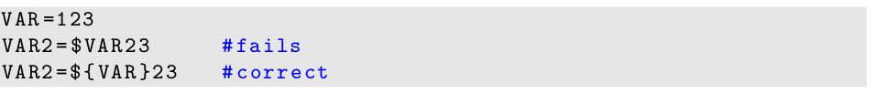
Shell variables
• value may be empty
• When expanding a parameter, braces {} are only required if the character which follows can be misinterpreted as part of the variable name

Slide 81
Shell variables
• Undefined variables expand to an empty string.
• All bash variables are stored as plain stringsbut they can be interpreted as
integers
• Variables can also be deleted using

Slide 82
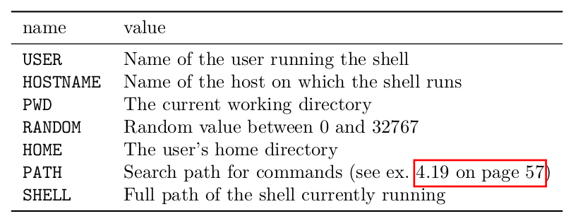
Shell variables
• A wide range of predefined variables exist

Slide 83
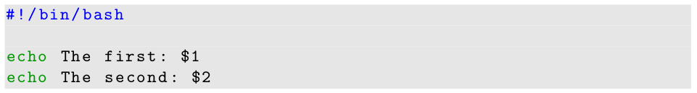
Special parameters
Apart from the variables we mentioned above, the shell also has a few special parameters
• positional parameters 1, 2, . . . ; expand to the respective argument passed to the shell script. E.g. if the simple script
is executed like
We get

Slide 84
Special parameters
• parameter @, which expands to the list of all positional parameters
• parameter #, expands to the number of positional parameters, that are non-empty
• parameter ?, expands to the return code of the most recently executed command list.
• parameter 0, expands to name of the shell or the shell script.

Slide 85
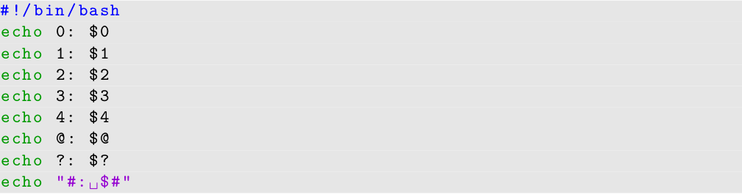
Special parameters
Another example - If the script
is executed like

Slide 86
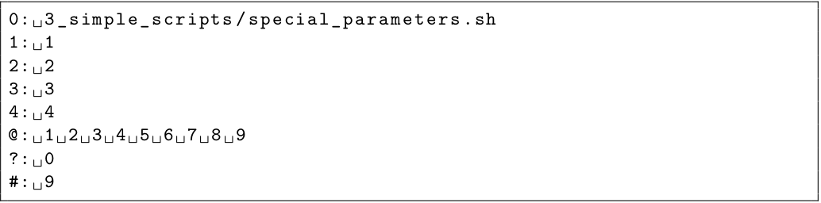
Special parameters
We get

Slide 87
Command substitution
In order to store the output of a command in a variable, we need a feature called command substitution
The basic syntax is:

Slide 88
Command substitution
• Command substitution only catches output produced on stdout, e.g. running
would still result in the “File not found” error message being printed on the terminal, since ls prints this message to stderr.
• Inside the $() we have a so-called subshell where output redirection is possible.

Slide 89
Command substitution
• Another consequence of the subshell is, that output of all commands within the $() is combined:
Gives:

Slide 90
Command substitution
• The return code of a command substitution is the return code of the internal
command list
i.e. the code of the last command executed.
So we could use
in order to inform the user that something went wrong with the ls command.

Slide 91
Command substitution
• Command substitution may be used as an argument for another command:
• Command substitutions may be nested:

Slide 92
Exercise!
Exercises 3.1 - 3.3

Slide 93
Escaping strings
Some characters are special to the bash shell:
• “$”: Initiates parameter substitution
• “#”: Starts a comment
• “;”, “&”, “&&”, “||”: Separate commands in a command list
• “\”: Starts an escape
• A few more

Slide 94
Escaping strings
It happens many times that one needs to use these characters not by their special, but by their literal, i.e. original meaning.

Slide 95
Escaping strings
Examples are:
• Printing data with echo
• Defining variables
In such a case we need to escape them, i.e. precede them by a \ character, e.g
Which produces

Slide 96
Escaping strings
A few more examples:
Will output
We can even escape newlines (Enter)
Will output

Slide 97
Word splitting and quoting
Right before the execution of a commandline the shell performs an operation called word splitting:
• The whole commandline is expected and split into smaller strings at each <newline>, <tab> or <space> character.
These smaller strings are called words.
• Each word is a separate entity:
The first word is the program to be executed and all following words are arguments to this command

Slide 98
Word splitting and quoting
Examples:
When the shell encounters the command line
it first substitutes the commands and parameters:
So the command executed is grep and it will be passed the five arguments search, 3, test, blubber, blub.

Slide 99
Word splitting and quoting
If we want to prevent word splitting at certain parts of the commandline we need to quote by either the single quote ' or the double quote " , e.g.

Slide 100
Word splitting and quoting
Similar to escaping, quoting also causes some special characters to loose their meaning inside the quotation:
• single quote ': No special characters, but ' survive
⇒ ", “$”, “#” are all non-special
⇒ No parameter expansion or command substitution
⇒ No word splitting
• double quote ": Only ", “$” and “\” remain special
⇒ We can use parameter expansion, command substitution and escaping
⇒ No word splitting

Slide 101
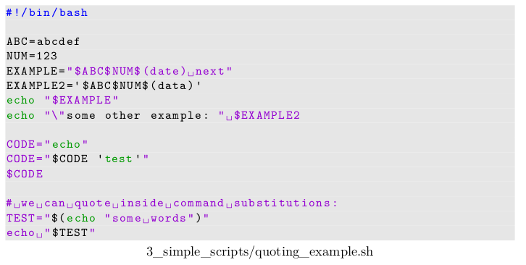
Word splitting and quoting
Consider the following script

Slide 102

Word splitting and quoting
The output will be

Slide 103
Word splitting and quoting
The only way to represent an empty string or pass an empty argument
to a function is by quoting it, e.g. calling
Will output

Slide 104
Word splitting and quoting
But the following (VAR is quoted)
Will output

Slide 105
Word splitting and quoting
Forgotten quoting or escaping is a very common source of error — some hints:
• When passing arguments to commands always quote them using double quotes (unless you have a reason not to)
⇒ This avoids problems when variables are empty
⇒ It does not hurt anything
• When initialising variables always quote the values on the right of the = using double quotes
⇒ Same reason as above

Slide 106
Word splitting and quoting
• When a variable contains a path be extra careful that you really use double quotes everywhere you use the variable
⇒ Paths or filenames may contain spaces
• Use syntax highlighting in your editor 10
⇒ You will discover missing escapes or closing quotes much more quickly

Slide 107
Exercise!
Exercises 3.4 - 3.7

